Slide 1
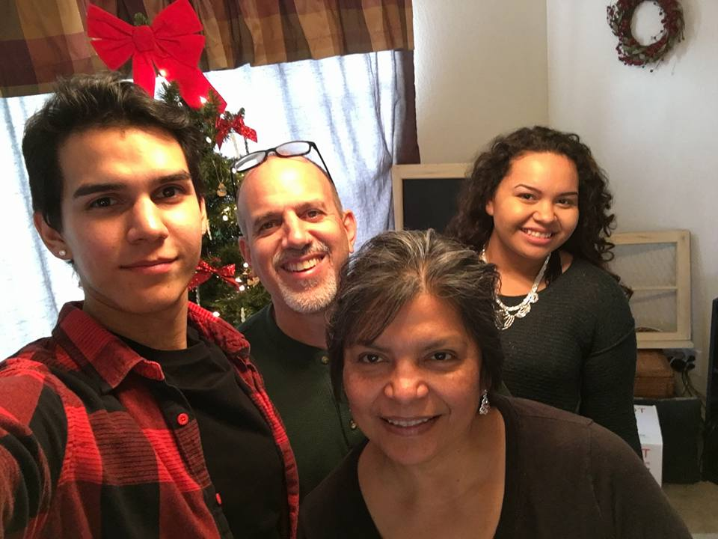
SHORT TERM MISSION TRIPS
Craig & Cheryl Cassel
Ethnos360

Slide 2
SHORT TERM MISSION TRIPS – 3 sessions
Day 1 – Preparation – Biblical & Personal Foundation
Day 2 – Mission Trip Land mines
Day 3 – Practical – Mechanics of the trip

Slide 3
Day 1 – Preparation – Biblical & Personal Foundation
Biblical Foundation – Does the Bible speak about missions?
Personal Foundation – What do you need to be ready?

Slide 4
Day 1 – Preparation – Biblical Foundation
Why Do mission trips?
Feed back
Biblical Foundation
“Missions” Biblical or not?
Small group – Find Biblical basis for Missions
Feed Back
Psalm 67 – All the world – all peoples
God’s heart – not just Israel
Luke 9:57-10:3 –What are we to pray for?

Slide 5
Day 1 – Preparation – Personal Foundation
Are you ready?
What are some ways you can ready yourself for a missions trip?
Feedback
Directed time in the Word –
study God’s heart for people
Study Jesus’ heart to serve
Directed time of prayer – the place your going, the people your serving

Slide 6
Day 1 – Preparation – Personal Foundation
Reflect on why you are going –
Your purpose
What you hope to accomplish
Are you ready for some change?
What’s God saying to you?
From your study and prayer time
Journal – write these things down
Share with others – team members

Slide 7
Day 1 – Preparation – Biblical & Personal Foundation Recap
Biblical Foundation – Does the Bible speak about missions? - Yes
Personal Foundation – What do you need to be ready? More than meets the eye.

Slide 8
Intentionally left blank

Slide 9
Day 1 – REVIEW
Biblical Foundation – Does the Bible speak about missions? - Yes
Personal Foundation – What do you need to be ready?
Directed time in the Word –
study God’s heart for people
Study Jesus’ heart to serve
Directed time of prayer –
the place your going,
the people your serving

Slide 10
SHORT TERM MISSION TRIPS
Day 2
Craig & Cheryl Cassel
Ethnos360

Slide 11
Day 2 Mission Trip Land Mines – things to avoid
A Training Tool for Disciplemaking
Friends and teams on mission.
by Cadre Missionary Bill Allison
The fact is that there are a lot of
mission trip land mines buried just
beneath the surface... waiting
patiently... for you or someone from
your group to make one wrong step.
Shouldn’t you know where
These land mines are buried so
you can avoid stepping on them?

Slide 12
Day 2 Mission Trip Land Mines – things to avoid
Story of a pitfall – Bill Allison
Ten Landmines to avoid on your Short Term Mission Trip

Slide 13
Mission Trip Land Mine #1
Romance
Tends to disrupt the unity of the team
Impact of the mission on those “romantically” involved is thwarted
not concerned about the mission experience
not focused on what God is doing but on each other
Sends inappropriate messages
Could set missionaries work back for a long time

Slide 14
Mission Trip Land Mine #2
An Inflexible Attitude
Why do we need to be flexible in our thinking/hearts?
Feedback
Ministry in another culture isn’t that cut and dried
Story – 30 bags of cement – no water
Stuff does go wrong – how will we handle it?
VBS – plan on 20 kids – you get 40 – how will we handle it?

Slide 15
Mission Trip Land Mine #3
An Undefined Work Project
We need to have clearly defined work projects
Each day there should be a basic idea what the team will be doing
Keeps the team’s focus on serving others
w/o this, focus turns on “being served” rather than serving
w/o this, focus turns from being “a missionary” to being a “tourist”
In being flexible, have a Plan A, Plan B, Plan C (just in case)

Slide 16
Mission Trip Land Mine #4
Focusing Too Much on the Work Project
A mission trip, like all ministry, is about people, not projects.
Don’t just build buildings, build friendships.

Slide 17
Mission Trip Land Mine #5
Withdrawal
What kind of things would we withdraw from?
Strange Food
Strange customs – Wampa & terere
Language
Have a “go for it” attitude
it gets you out of your comfort zone/
causes you to trust God
once you leave, it’s too late to have that experience again

Slide 18
Mission Trip Land Mine #6
A Lack of Orientation
Pre-field training is often the difference between a good short term mission trip and a bad one.
During orientation, the leader must communicate pertinent information about such things as culture, interpersonal relationships, and any rules for the team’s trip.
A thorough and engaging orientation program helps the team build momentum for the mission trip.

Slide 19
Mission Trip Land Mine #7
Fatigue
What are some “dangers” for a team who is fatigued?
Emotional unraveling
Get on each others nerves
Words are said that shouldn’t be
Work ethics slip
complaints start to roll off the tongue
team unity gets low

Slide 20
Mission Trip Land Mine #8
A Lack of Food
What kind of “trouble” can come from a lack of food?
What are the benefits of having plenty to eat?
A well-fed group is a happy group.
a happy group stands to gain much from a mission experience.
Have plenty of water and light mid-day snacks

Slide 21
Mission Trip Land Mine #9
A Lack of a Biblical Foundation
a mere 9 percent of all people who claim to have a relationship with Jesus Christ actually hold to a biblical worldview.
Without a biblical foundation for missions involvement, people will base their trip on emotions.
Emotions go up and down – fluctuate all over the place
God’s Word is stable – unchanging
God’s Word can override our unstable emotions

Slide 22
Mission Trip Land Mine #10
Culturally Insensitive Dress
It's very important to know what the appropriate dress is for the area in which you will be working.
the goal is to blend in as much as possible, not to stick out
Women have to be careful about their shirts – the less revealed the better
Guys working with shirts off is offensive in some cultures.
Do your homework and use discretion.

Slide 23
What Now?
1. Give this article to each person on your mission team and have them read it—marking it with a pen as they read.
2. Gather the team together to discuss the article.
3. Have each person sign off on the Checklist Covenant on the next page.
4. Guide the team through the Free Mission Trip Training Session included in this article.

Slide 24
Intentionally left blank

Slide 25
Day 1 & 2 – REVIEW
Biblical Foundation – Does the Bible speak about missions? - Yes
Personal Foundation – What do you need to be ready? Directed time in the Word –
study God’s heart for people
Study Jesus’ heart to serve
Directed time of prayer – the place your going, the people your serving
We saw 10 Pitfalls or landmines to avoid.
We want and need to avoid landmines in order to not have a negative affect on the ministry that we are partnering with.

Slide 26
SHORT TERM MISSION TRIPS
Day 3
Craig & Cheryl Cassel
Ethnos360

Slide 27
Day 3 – Practical – Mechanics of the trip
Identify Clear Purpose of the Trip
Purpose/Goals at the Location
Building - Construction
VBS
Adult Bible Study
Health/Clinic
Purpose/Goals for your Church
Enhance your congregation’s understanding of God’s work in the world
Allow your congregation to learn from Christ's Body in other parts of the world.
Challenge your congregation to get involved in what God is involved in

Slide 28
Day 3 – Practical – Mechanics of the trip
Duration
Consider the amount of time potential participants have available
Summer vacation
Winter vacation
Work vacation
How Long for the actual ministry time
What’s good for the church/ministry location you are going to?
What’s needed for the particular project/ministry
How long for travel to and fro
How far away is the location
Drive or Fly

Slide 29
Day 3 – Practical – Mechanics of the trip
Partnership with a Local Church / Ministry
Why would we want to partner with a local church?
Helps ensure there is follow up for evangelism
Helps ensure there is follow up for discipleship
We don’t just want converts, we want disciples who make disciples
Passetti Story – 1st Baptist Church Camdenton MO.
Mexico – Eyeglass and medical
Local church –
hundreds of people seen and given glasses
40 committed to ongoing Bible Study
Church doubled in size from one year to the next – Disciple making disciples

Slide 30
Day 3 – Practical – Mechanics of the trip
Careful planning
Committee? (share the burden)
Purpose
Ministry site
Contact potential host (see if ministry is needed)
Establish team leaders for the trip
Co-ordinates dates with host/team
Set size of team
Set cost of trip
Checklist for onsite needs etc.

Slide 31
Day 3 – Practical – Mechanics of the trip
Clear communication
Good team communication
Team to Your sending church
Team to Your host church/ministry location

Slide 32
Day 3 – Practical – Mechanics of the trip
Focused Prayer
Through-out pre-trip preparations
planning
team formation/selection
effective ministry
During On-site ministry time
Post trip reflection time (weeks after the trip)

Slide 33
Day 3 – Practical – Mechanics of the trip
Building The Team
Publicity – Make the trip known to your congregation (over & over)
Recruit –
we want as many people as possible to connect with an opportunity.
It may take multiple times of sharing the vision for the trip in various settings.
Application forms?
Requirements?
Selection process?

Slide 34
Day 3 – Practical – Mechanics of the trip
Team Building
Pre-Trip Meetings
Team building activities
Team work – Saturday Workday -
Relationships
Conflict resolution/Forgiveness/Respect for one another
One Anothering

Slide 35
Day 3 – Practical – Mechanics of the trip
Team Building
Pre-Trip Meetings (Continued)
Adminstration (logistics, time line, forms/medical, support – raising, packing, travel, thank you and prayer letters)
Training sessions (team building, heart & spirit (pg 19), cultural knowledge, skills (construction, painting, puppets, teaching),
prayer time (pg 21)

Slide 36
Day 3 – Practical – Mechanics of the trip
On Trip Meetings
Bible Study/Devotions
Servanthood, humility, relationship w/God
Testimony time – What is God doing in you?
Informational (what’s tomorrows plan)
Evaluation (What went well today? What can we improve on? what do we need to change or adjust? What should stay the same?)

Slide 37
Day 3 – Practical – Mechanics of the trip
Post Trip Meetings
A time to debrief – process all that went on (on site?)
A time to tell your story –
1st in your group
2nd to your church
A time to brainstorm – Seek God’s direction. Now what?
How do we use what we learned… (put feet to our faith)
at our home church
in our community

Slide 38
Day 3 – Practical – Mechanics of the trip
Team follow-up. (by team and church leaders)
Don’t let it just drop off.
Continue the journey of becoming…
Global Christians who…
cultivate a Christ-like compassion for our needy world.

Slide 39
THE END
THANK YOU …

